Slide 1
Atmospheric Instability
Cloud Formation & Precipitation

Slide 2
Outline
Achieving Precipitation
Lifting Mechanisms
Orographic
Frontal
Convergent
Convectional – Unstable Atmosphere
Terms & explanations

Slide 3
Precipitation
Precipitation is dependant upon several factors:
Saturation
Addition Of Water Vapor
Mixing Of Cold Air With Warm, Moist Air
Lowering Temperature To The Dew Point
This is the method by which clouds are formed
Condensation
Cloud formation (Dependant upon Condensation Nuclei)
Precipitation occurs when condensation produces sufficiently large raindrops to fall to Earth

Slide 4
Lifting Mechanisms
Rising air expands doing work on environment. Work uses “internal” energy reducing Temp
Clouds are formed by cooling the air to the dew point temperature.
How does this occur?
Lifting of air through the atmosphere
However, this ‘Lifting’ generally does not occur spontaneously.
Air, typically, will only rise if it is forced to do so
Otherwise it will remain at its present location
In this situation, air is deemed to be ‘STABLE’

Slide 5
Lifting Mechanisms
Lifting Mechanisms
Orographic
Stable Air is FORCED aloft
Frontal
Stable Air is FORCED aloft
Convergent
Two Colliding Stable Air Masses are FORCED aloft
Convectional
Air is buoyant and rises on its own accord
In this situation, air is deemed to be ‘UNSTABLE’

Slide 6
Orographic Lifting
Stable Air can be FORCED to rise up & over a barrier, like a range of mountains.
If the mountains are high enough:
Clouds form and rain falls on the windward side, and
The leeward side remains dry.
‘Rain Shadow Effect’

Slide 7
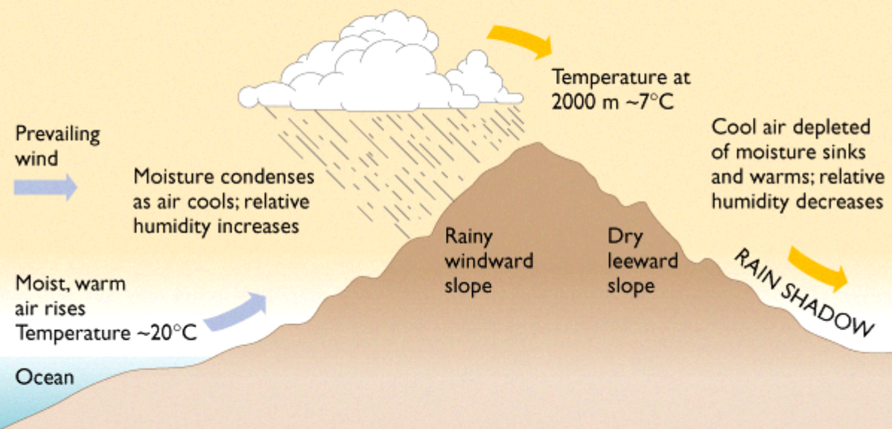

Slide 8
WINDWARD SIDE
LEEWARD SIDE
Ascending Air
Cooling (Condensation)
Clouds
Rain?
Descending
Warming (evaporation)
No clouds – Rain Shadow
Dry air – Different Veg.
Mountain

Slide 9
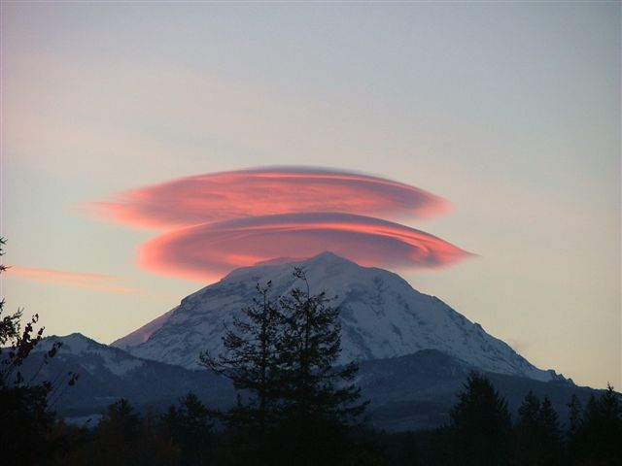

Slide 12
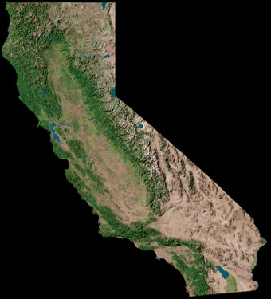
California

Slide 13
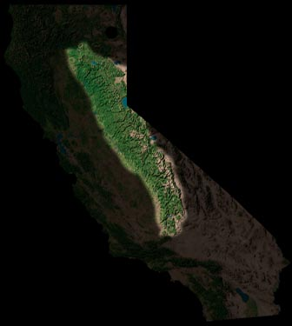
Sierra
Nevada
John Muir
Wilderness
Death
Valley

Slide 14
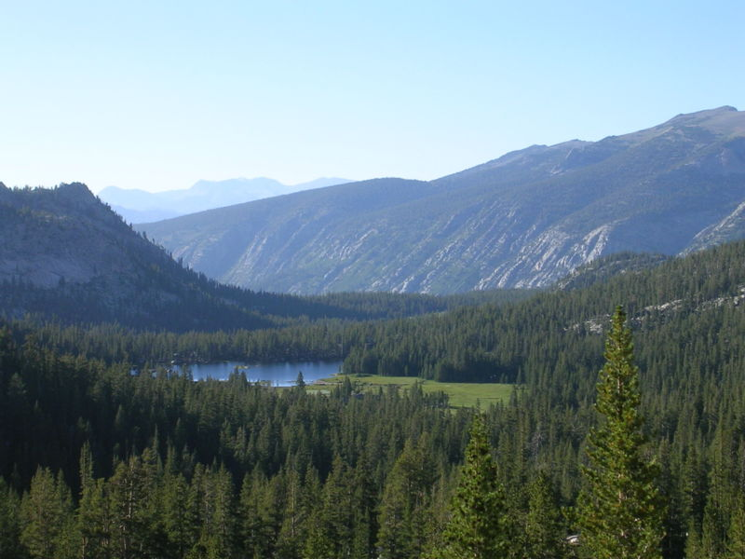
John Muir Wilderness

Slide 15
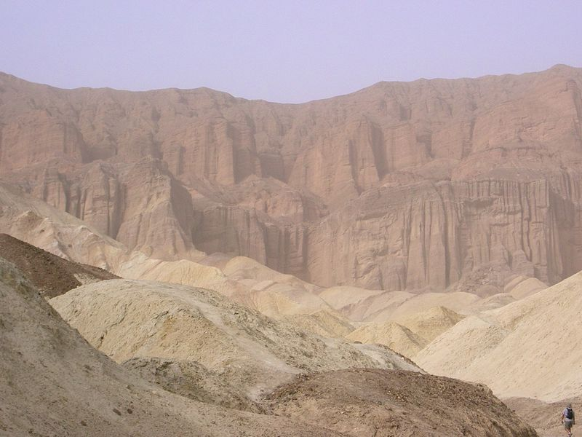
Death Valley
Lowest elevation in North America at 282 ft (86 m) below sea level. Receives < 2” Rain annually!

Slide 16
Frontal Lifting
When two (Stable) air masses meet, the warmer or wetter air will be forced up and over the colder or drier air.
AIR MASS
A horizontally and vertically extensive body of air with similar moisture and/or temperature characteristics throughout
FRONT
The boundary between two air masses

Slide 17
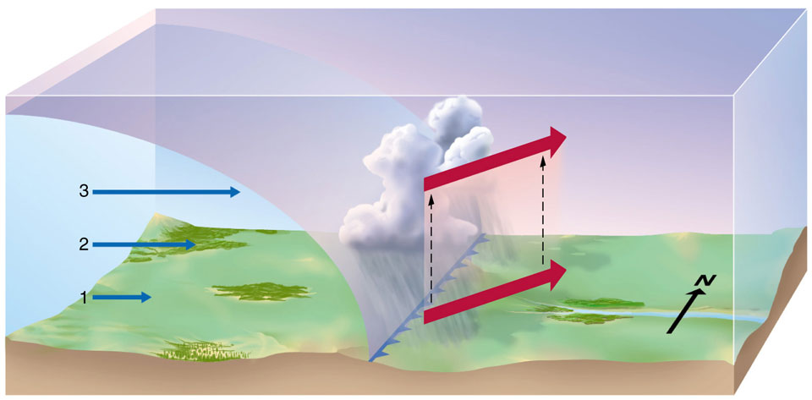
COLD FRONT:
Cold (Stable), dense, air moves into warm (Stable) air.
Cold Front like locomotive not slowed much by light warm air. Temp difference creates circulation thus air aloft actually slower than surface (opposite of normal and what book says!)
Warm moist air rises rapidly, producing heavy rain, hail, and possibly thunder

Slide 18
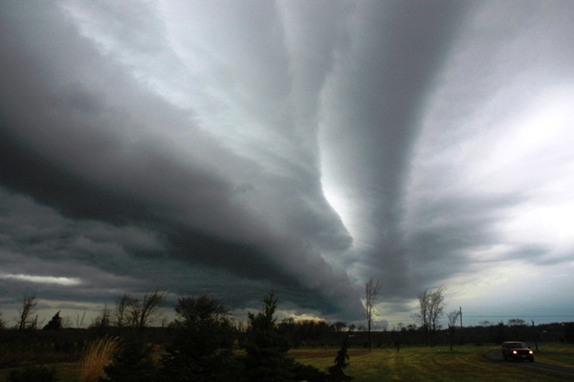

Slide 19
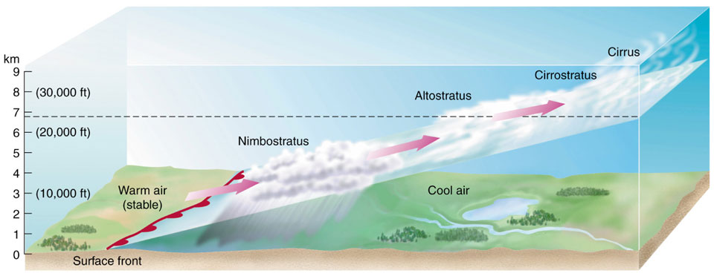
WARM FRONT:
Warm (Stable) air advances towards, and slides up and over, cold (Stable), dense, air
Slope is relatively flat because warm air can’t move surface air but can move air aloft because there is MUCH more friction at surface but not aloft
Overcast, light rain, drizzle, AHEAD of the WF
As Warm Front approaches, clouds will have lower altitudes

Slide 20
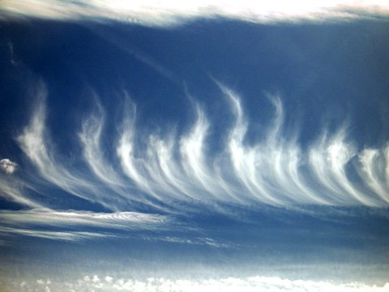
CIRRUS

Slide 21
CIRROSTRATUS

Slide 22
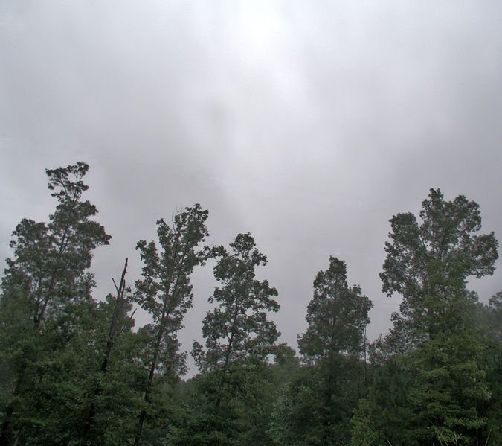
ALTOSTRATUS

Slide 23
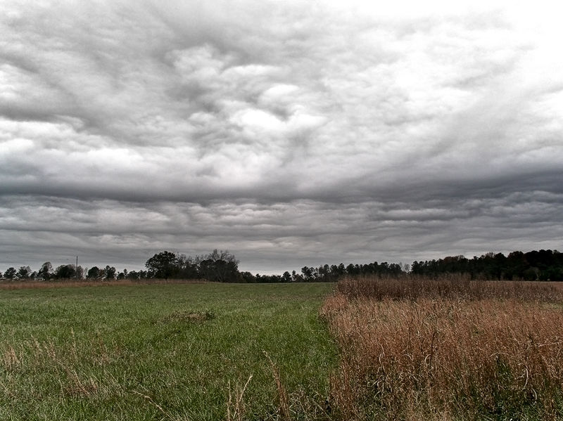
NIMBOSTRATUS

Slide 24
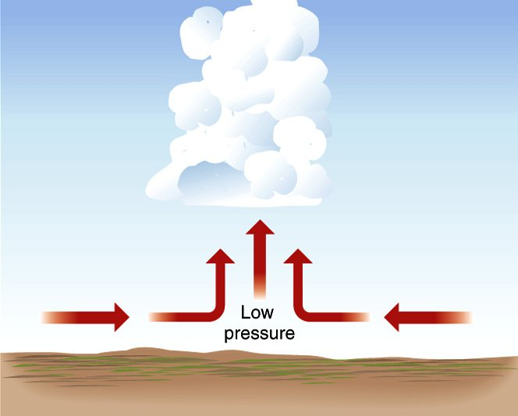
Convergent Lifting
Air Masses sucked into Low Pressure at the surface.
They Collide and are forced upward

Slide 25
Convectional Lifting
Hot Air Rises.
Any parcel of air that is warmer than surrounding air will rise
Just because it is less dense…This is Convectional Lifting
Requires UNSTABLE atmosphere
An Unstable atmosphere’s Temp continues to be much cooler than parcel as it rises.
It rises until parcel Temp=atmosphere Temp ie. TROPOPAUSE (remember this?)

Slide 26
Convectional Lifting
WHY DOES HOT AIR RISE?????
Warm air molecules move very fast
This causes the parcel to expand.
Once expanded, the air parcel has a lower density than the surrounding air
It is lighter – so it rises
Once the Temperature and Density of the Air Parcel is equal to that of the surrounding air:
It will cease to rise.

Slide 28
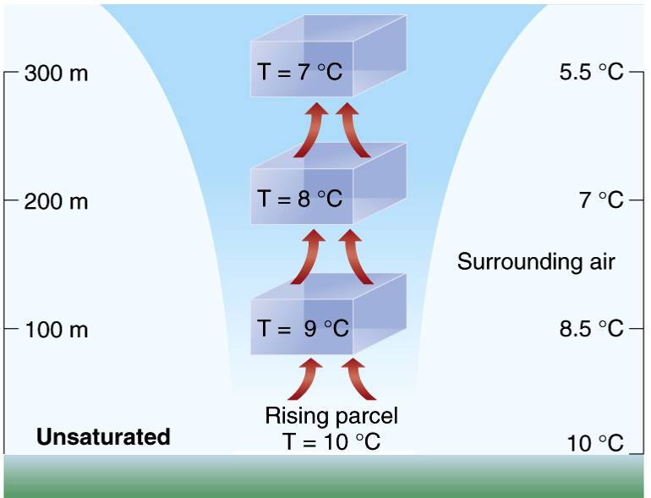

Slide 29
Adiabatic Processes
DIABATIC Temperature changes
Temperature changes that occur through the addition or subtraction of heat.
ADIABATIC Temperature changes
Temperature changes that occur without the addition or subtraction of heat.
Good approx. since parcel rises fast so there is little time for heat transfer with environment
When air EXPANDS, it cools adiabatically
When air CONTRACTS, it warms adiabatically

Slide 30
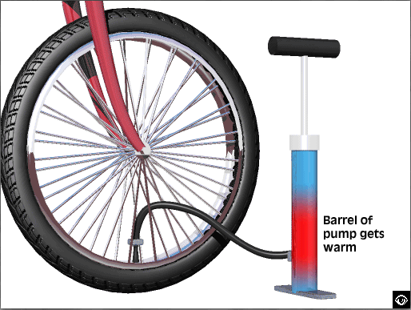

Slide 32
Adiabatic Processes
Expanding/Rising Air
The act of expansion of a parcel of air causes it to cool.
Cooling occurs because expanding parcel does work on surroundings requiring energy
But no energy is added.
Instead, INTERNAL energy from inside the parcel is used for expansion,
Thus the parcel cools.
This is similar to you not eating but using up energy you have already stored inside you…

Slide 33
Lapse Rate
Rate at which a variable DECREASES with an INCREASE in another variable.
In metereology we are concerned with the decrease in temperature with increase in height.
If you do the math, it turns out the Temperature of UNSATURATED air parcel decreases LINEARLY with height
Note: Sometimes Unsaturated is called “DRY” because there is no liquid water. BUT there is water vapor but it is unsaturated.

Slide 34
Dry Adiabatic Lapse Rate (DALR)
10 °C per 1000m rise.
It is used for DRY (RH < 100%) Air regardless of method of lifting
Is used for Dry air below the condensation level
The point at which air becomes saturated
Same for every location as long as DRY
We compare this lapse rate to that of the surrounding air to determine stability of the air

Slide 35
Environmental Lapse Rate (ELR)
The Lapse Rate of Actual atmosphere air at a given location (NOT the parcel)
ELR changes over time and between locations
Varies between about 5 and 15 °C per 1000 m rise
ELR is for air that is not moving
It must be measured for each location.
In any question, you will be given the ELR.

Slide 36
Standard ELR
6.4 °C per 1000m rise (1000km=1km)
The global average rate of temperature decrease with elevation increase throughout the Troposphere for DRY air.
Used for DRY (RH < 100%) air.
The air is NOT moving.
The temperature decrease is seen as YOU move UP THROUGH the air.
As is seen with a weather balloon (Radiosonde)
Is not the same as the Actual ELR for a given time and location (unless the Actual ELR = 6.4 C/km !!!)

Slide 37
Atmospheric Instability
Stable air means if parcel is lifted adiabatically in it , it will return to earth
If the Parcel is COOLER and DENSER than Surroundings as it ascends, it will sink thus it is STABLE
Compare the temperature of parcel to surroundings using graph of actual lapse rate vs. parcel adiabatic lapse rate

Slide 38
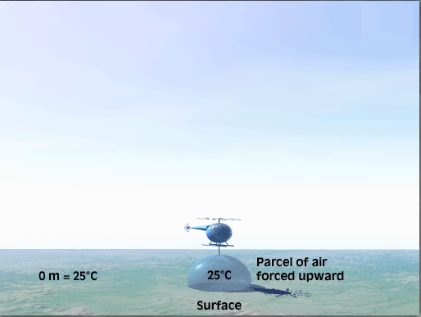
STABLE ATMOSPHERE

Slide 39
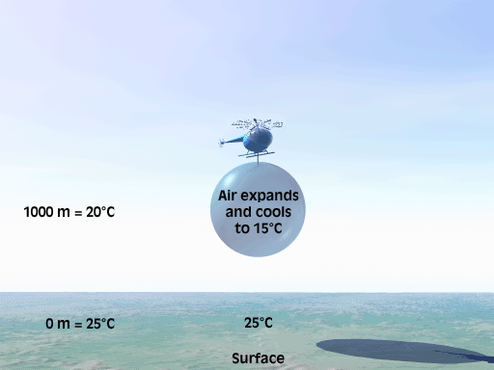
ABSOLUTELY STABLE

Slide 40
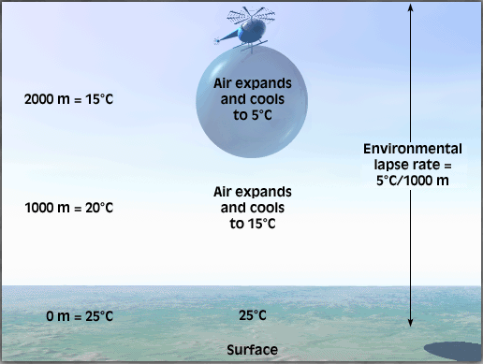
STABLE ATMOSPHERE

Slide 41
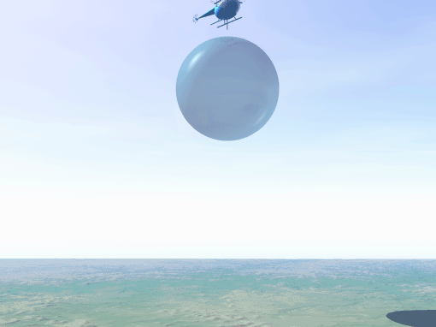
ABSOLUTELY STABLE

Slide 42
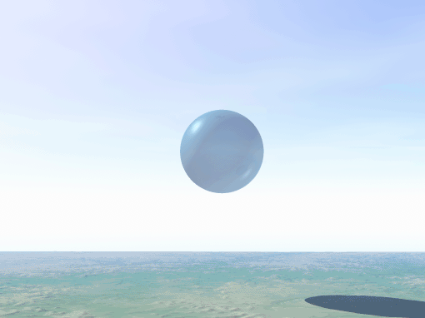
ABSOLUTELY STABLE

Slide 43
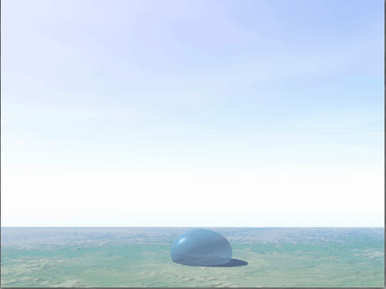
STABLE ATMOSPHERE
Resists Vertical Movement
Can Only Be Forced Aloft!

Slide 44
STABLE AIR
DALR
ELR
Elevation
Any elevation
Cooler /Denser
Temperature

Slide 45
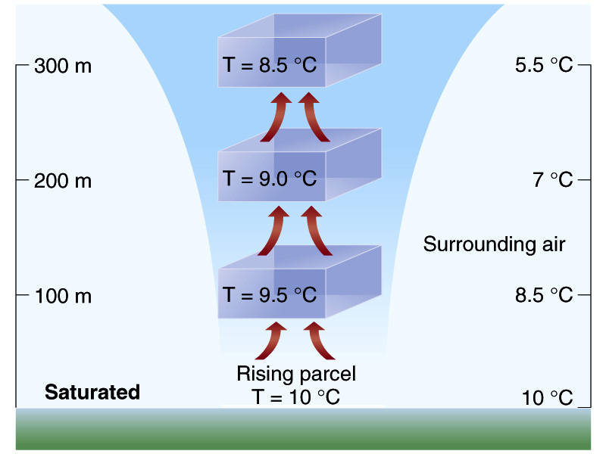
UNSTABLE ATMOSPHERE
ELR = 15C/1000m

Slide 46
UNSTABLE
DALR
Hotter/Buoyant
Elevation
ELR
Any elevation
Temperature

Slide 47
Becoming Saturated…
Rising dry air will sometimes reach condensation level
RH = 100%, where air temp is equal to dew point temp, and clouds will form.
SOMETIMES, the air will keep rising, and keep cooling.
But since it is now saturated, it cools at a different rate because of energy released from condensation.
Saturated air may also start rising from the ground, so it never experiences the DALR

Slide 48
Saturated Adiabatic Lapse Rate (SALR)
SALR cools slower than the DALR.
Condensation releases latent heat and thus warms the air
While there is a net cooling effect, it is offset by the slight addition of heat from condensation.
Latent Heat of Condensation
Thus, SALR is always a slower rate than 10 °C per 1000m (5-9 C per 1000m)
Its line on a graph will always be STEEPER than that of the DALR.

Slide 49
Saturated Adiabatic Lapse Rate (SALR)
SALR is NOT same for every time/location but depends on Temperature.
A very cold atmosphere will have less water vapor at saturation thus less condensation therefore cools more like dry atmosphere
A warmer atmosphere has more water vapor at saturation thus more condensation and more latent heat so cools much LESS than dry atmosphere
i.e. Very Warm atmosphere cools 5 C per 1000m and very Cold atmosphere cools 9 C per 1000m)

Slide 50
ABSOLUTELY STABLE
SALR
ELR
Elevation
DALR
Any elevation
cooler
Temperature

Slide 51
ABSOLUTELY UNSTABLE
DALR
SALR
Elevation
hotter
ELR
Any elevation
Temperature

Slide 52
Conditionally Unstable Air
Stable when dry (RH < 100%),
Unstable when saturated (RH = 100%)
There is a “Condition” on whether the parcel is stable or unstable, the condition being saturation.

Slide 53
CONDITIONALLY UNSTABLE
DALR
SALR
ELR
hotter
Elevation
Any elevation
cooler
Temperature

Slide 54
Saturation Point
At Condensation Level, parcel temp becomes equal to dew point temp, so RH = 100%
Dew Point decreases with height not because of change in mass of vapor but because pressure/density decrease (small effect)
DEW POINT TEMPERATURE ALWAYS DECREASES Slower Than Dry Adiabatic Lapse Rate
As a result, DEW POINT TEMPERATURE intersects with air temp at some elevation
This is Lifting Condensation Level

Slide 55
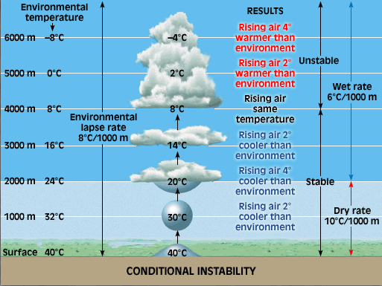
Level Of Free Convection
Condensation Level

Slide 56
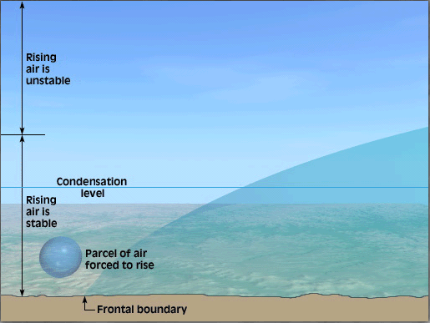

Slide 57
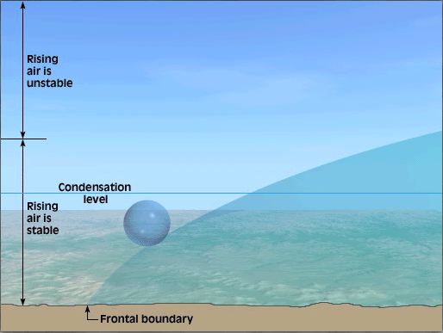

Slide 58
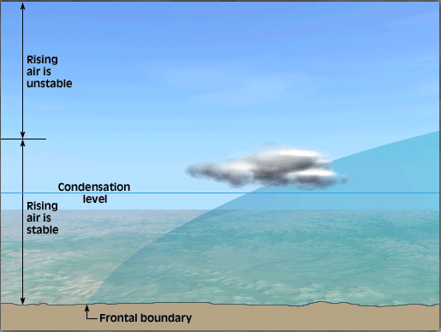
Level Of Free Convection

Slide 59
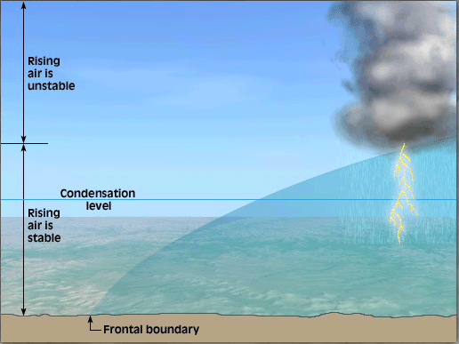
Level Of Free Convection

Slide 60
